Slide 1
“The Caffeinated Quantum Squadron” YouTube comment Sentimental Analysis
April 27th, 2023

Slide 2
Introduction
Mission of pipeline
Creating pipeline as a team
Aims to achieve

Slide 3
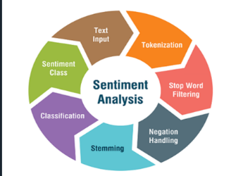
Technologies and Methods
Kanban and Agile Methodology
Github and continuous integration
Docker and Airflow deployment

Slide 4



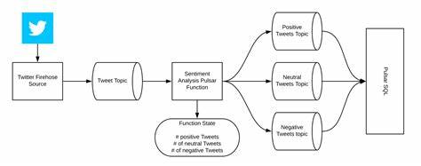
How YouTube sentimental Analysis is working

Slide 5

Pipeline Tutorial and Demo
Functionality Demonstration
Connect To Kaggle
Please ask specific functionality questions now!

Slide 6
Application Technology
Docker Airflow
Extracting comments using API
Classification and Clearing (NLTK)

Slide 7
Difficulties and acknowledgements
Importing NLTK with the AIrflow
Getting API
Distribution of tasks

Slide 8
Conclusion
Youtube Sentemetal Dataset has been Created
Connected With Kaggle
Queries ?

Slide 9


Slides prepared by The Caffeinated Quantum Squadron
Add your
Data Engineers at Youtube sentimental Analysis who work to change the world and improve the lives of people around the globe. Graduates from Roehampton in 2023 with a degrees in Computer Science. Love to work improving the future with a diverse and dedicated staff.
The Caffeinated Quantum Squadron make no claim to ownership of Media images in this powerpoint. Images taken from Google.

